Slide 1

Code Refactoring and Bug Fixing
on Note making app
By Nithish J P

Slide 2



About me
I am an enthusiastic and driven Artificial Intelligence and Data Science student, deeply passionate about leveraging technology to solve real-world problems. Throughout my academic journey, I have actively engaged in numerous projects related to data science and machine learning, where I have acquired valuable skills and practical experience in analyzing complex datasets, developing predictive models, and deriving actionable insights. As I approach the culmination of my academic studies, I am eager to gain industrial exposure and apply my knowledge in a professional setting. I am particularly interested in exploring opportunities to contribute to innovative projects and further develop my skills in data science
Link to Project Repo : https://github.com/Nithish2022/AMEO_2015_EDA
Link to my Linkedin Profile : https://www.linkedin.com/in/jpnithish58/
Mail : nithishjp58585@gmail.com

Slide 3
The Note Taking Application is a simple web-based tool built using Python, Flask, and HTML. Its primary objective is to provide users with a platform to add, view, and manage notes conveniently. The application allows users to input text notes through a web form, and it displays all the added notes as an unordered list on the same page.
Project Description:

Slide 4
Bug description :
When submitting a note through the form, it doesn't get added to the list of notes displayed on the page.
Issue Identification:
In the index() function of app.py, request.args.get("note") is used to retrieve the note from form. However for form submission using POST method, it should be request.form.get("note").
Clicking the "Add Note" button doesn't submit the form.
Issue Identification:
In home.html, the form lacks the method attribute, causing it to default to GET method instead of POST. Additionally, the button lacks the type attribute, causing it to not submit the form.

Slide 5
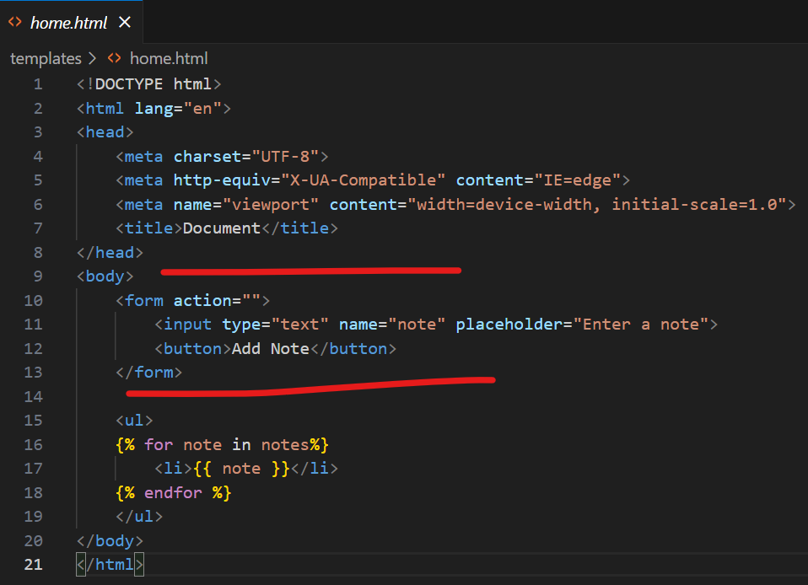
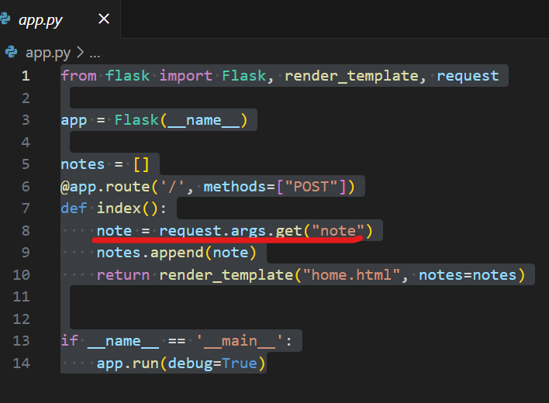
Bugs present:

Slide 6
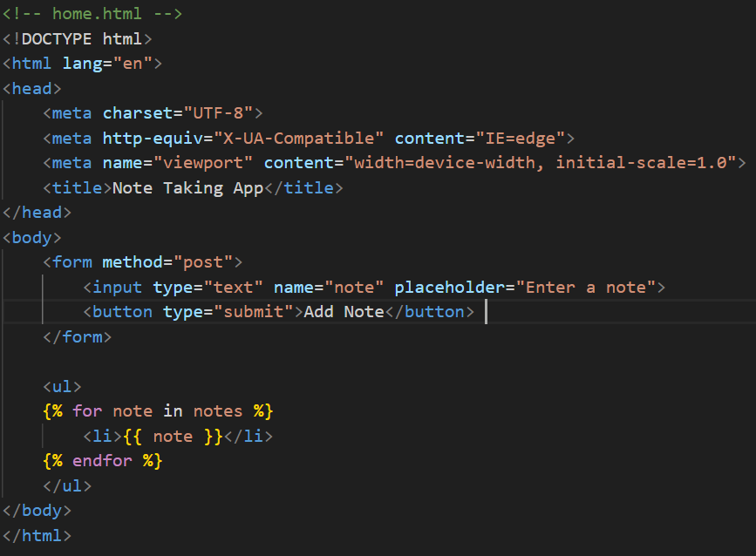
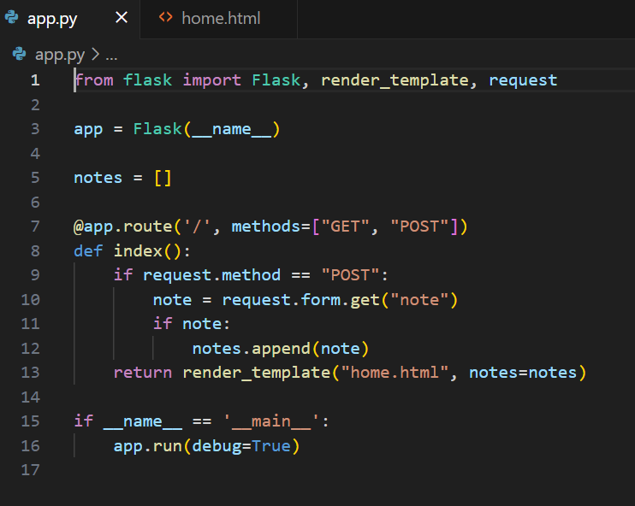
Fixing the bugs:

Slide 7
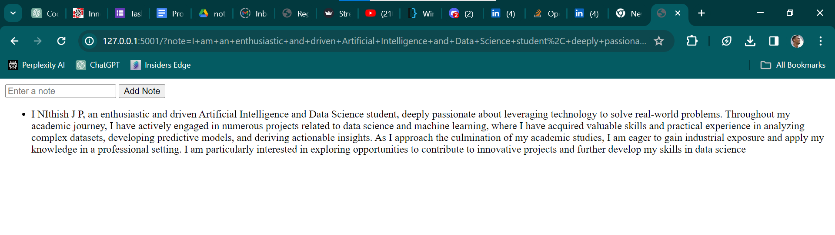
Outcome of Deployed app :

Slide 8

THANK YOU

